Slide 1
Customer Default Risk Analysis Dashboard
Identifying key trends to avoid default-prone customers
Live Power BI report embedded

Slide 2
Business Problem & Objectives
Business Problem:
Payment defaults are detrimental to the business and are a significant cost factor.
Are there any key trends in the data that can help avoid default-prone customers in the future?
Key Question:

Slide 3
RFM Assumptions & Methodology
Why RFM? − Proven technique to flag early‐risk patterns and tailor engagement. − More predictive than demographics alone, it aids both fraud detection and marketing
Scoring (1–3) Logic
Recency (R): 1 = ≤ 641 d │ 2 = 642–961 d │ 3 = > 961 d
Frequency (F): 1 = ≤ 8 txns │ 2 = 9–28 txns │ 3 = > 28 txns
Monetary (M): 1 = ≤ 17 k AUD │ 2 = 17 k–33 k AUD │ 3 = > 33 k AUD
Each customer is assigned a three-digit RFM score (e.g. 3-1-2) for segmentation.
RFM Score/Condition | Segment Name | Description
333 | Best Customers | High spenders with frequent and recent payments
R=3, F=2, M≥2 | Loyal Customers | Active and regular contributors with good value
R=3, F=1 | Recent Buyers | Newly active customers with fewer transactions
R=2, F=3 | Frequent Buyers | Highly frequent, mid-recent customers
R=1, F=3 | At Risk Loyalists | Previously loyal but no recent activity
111 | Dormant Customers | Low across all dimensions—least engaged
R=1, F=1, M=3 | Big Spenders Gone Silent | Large past spenders who are now inactive
R=2, F=2, M=2 | Potential Loyalists | Average but stable, opportunity for growth
R=3, F=3 | Frequent but Low-Spending | Very active, but low overall contribution
Other combinations | Others | Do not fall into a defined strategic group
Percentile | Recency (days) | Frequency (count) | Monetary (amount)
25% | 321 | 8 | 8,050.02
50% | 641 | 18 | 17,003.73
75% | 961 | 28 | 33,336.57
Max | 1,281 | 105 | 284,276.59
:
Resources:
https://www.analyticsvidhya.com/blog/2021/07/customer-segmentation-using-rfm-analysis/
https://documentation.bloomreach.com/engagement/docs/rfm-segmentation
https://medium.com/@yennhi95zz/using-rfm-analysis-for-effective-customer-segmentation-in-marketing-4964a99bf606

Slide 4


Microsoft Power BI

Slide 5
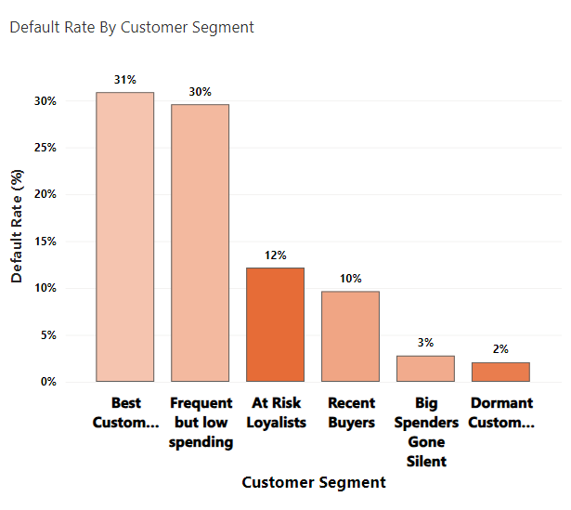
Insight 1: Default Rate By Customer Segment
Key Insights
Best Customers (31%) and Frequent Low Spenders (30%) have the highest default rates.
Dormant and Silent segments default below 5%, driven by inactivity rather than stability.
Small segment sizes (e.g. only 3 “Best” clients) can amplify default percentages.
At-risk customers have maximum transactions (10k) but comparatively low default rates (12%).
Interpretation
High RFM scores don’t guarantee low risk—historical loyalty segments can flip into high-risk if payment behaviour sours.
Recommendations
Watch big spenders closely so you spot missed payments early.
Don’t rely only on past loyalty—always check recent payment history before extending credit.
Set up quick alerts or stricter terms for top customer groups when they start to slip.

Slide 6
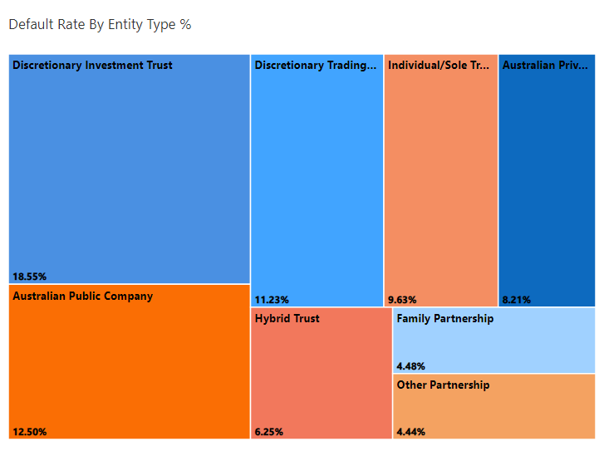
Insight 2: Default Rate By Entity Type
Key Insights
Discretionary Investment Trusts (18.6%) and Australian Public Companies (12.5%) have the highest default rates.
Individual/Sole Traders and Discretionary Trading Trusts show moderate risk (~9–11%).
Family and Other Partnerships report the lowest defaults (~4–5%).
Interpretation
Entity legal structure correlates with payment risk.
Complex or large‐scale trust and corporate forms tend to default more often, while partnership models demonstrate stronger repayment behaviour.
Recommendations
Embed entity type into credit scoring to flag high‐risk structures (trusts, public companies).
Apply stricter terms or enhanced due diligence for trust‐based and corporate entities.
Leverage partnerships as lower‐risk opportunities when allocating credit or structuring repayment plans.

Slide 7
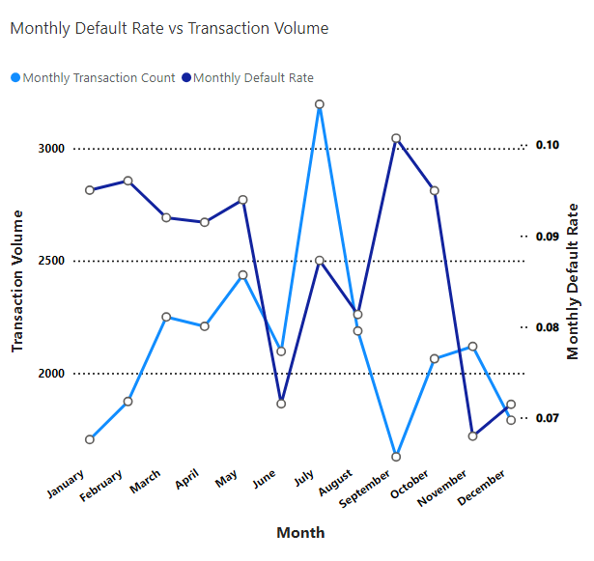
Insight 3 : Monthly Default Rate vs Transaction Volume
Key Insights
July, being a financial year, had the highest number of transactions but one of the lowest default rates, showing strong payment performance during peak activity.
September and October experienced spikes in default rate despite a drop in transaction volume, indicating risk factors beyond just transaction load.
November–December (cooling months) saw both transaction counts and default rates remain low and stable, closing out the year on steady footing.
Interpretation
High volume ≠ high risk: Customers kept up with payments even when business was busiest.
Default risk peaks in off-peak months, suggesting seasonal cash-flow pressures, shifts in customer mix, or external economic influences.
End-of-year stability points to predictable behaviour once seasonal spikes pass.
Recommendations
Targeted monitoring in September and October: deploy extra credit checks or reminder campaigns during these higher-risk months.
Proactive alerts in peak-risk periods: set up automated notifications when default rates begin to climb.
Seasonal risk planning: Adjust underwriting criteria or payment terms ahead of known high-default windows to safeguard cash flow.

Slide 8
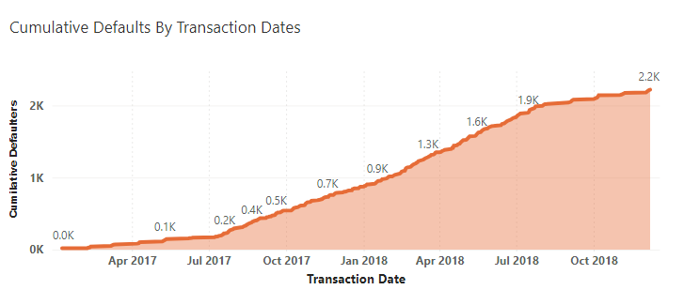
Insight 4: Cumulative Defaults Over Time
Key Insights
Rapid rise in defaults from mid-2017 through mid-2018, adding nearly 1,300 new defaults in that year.
After mid-2018, the slope flattens, with only about 300 more defaults by year-end.
Interpretation
A wave of high-risk clients or weaker onboarding drove the large jump in defaults during 2017–2018.
Changes made around mid-2018—like tighter screening or updated credit policies—appear to have slowed new defaults significantly.
Recommendations
Audit the customer criteria and onboarding steps used in early 2017 to pinpoint where the risk was missed.
Standardise the improved screening and controls introduced in mid-2018 for all new clients.
Set up a monthly review of the cumulative defaults curve to catch any future upticks early.

Slide 9
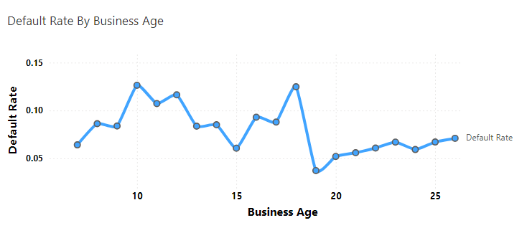
Insight 5: Default Rate by Business Age
Key Insights
Default risk is highest for businesses aged 10–15 years (around 12–13%).
As businesses age beyond 15 years, default rates steadily decline, falling below 6% after 20 years.
Interpretation
Younger and mid-aged companies face more payment challenges—likely due to limited track records and financial resilience—while long-established firms tend to manage repayments more reliably.
Recommendations
Apply stricter credit checks or shorter payment terms for businesses under 15 years old.
Offer more favourable terms or volume discounts to clients over 20 years old who have demonstrated strong payment behaviour.
Use business age as a quick risk flag in the underwriting process.

Slide 10
Top 3 Key Trends to Spot and Avoid Future Defaults
“Top” RFM Segments Aren’t Always Safe
The highest-value customers (“Best” and “Frequent but low-spending”) show the highest default rates (30-31%).
Takeaway: Don’t assume past loyalty or volume guarantees on-time payments—monitor these high-exposure segments closely.
Younger Businesses Carry More Risk
Companies under 15 years old have default rates above 10–13%, while those 20+ years consistently stay below 6%.
Takeaway: Use business age as a quick risk filter—apply stricter terms or extra vetting for newer firms.
Default Spikes Don’t Follow Volume
Peak transaction months (e.g., July) see low defaults, whereas September–October (off-peak) show notable rises in default rates.
Takeaway: Schedule targeted reminders, credit checks, or tightened terms in historically high-default windows, rather than focusing only on busy periods.

